Slide 1



chapter 5
interaction design basics

Slide 2
interaction design basics
design:
what it is, interventions, goals, constraints
the design process
what happens when
users
who they are, what they are like …
scenarios
rich stories of design
navigation
finding your way around a system
iteration and prototypes
never get it right first time!

Slide 3
interactions and interventions
design interactions not just interfaces
not just the immediate interaction
e.g. stapler in office – technology changes interaction style
manual: write, print, staple, write, print, staple, …
electric: write, print, write, print, …, staple
designing interventions not just artefacts
not just the system, but also …
documentation, manuals, tutorials
what we say and do as well as what we make

Slide 4
what is design?

Slide 5
what is design?
achieving goals within constraints
goals - purpose
who is it for, why do they want it
constraints
materials, platforms
trade-offs

Slide 6
golden rule of design
understand your materials

Slide 7
for Human–Computer Interaction
understand your materials
understand computers
limitations, capacities, tools, platforms
understand people
psychological, social aspects
human error
and their interaction …

Slide 8
To err is human
accident reports ..
aircrash, industrial accident, hospital mistake
enquiry … blames … ‘human error’
but …
concrete lintel breaks because too much weight
blame ‘lintel error’ ? … no – design error we know how concrete behaves under stress
human ‘error’ is normal
we know how users behave under stress
so design for it!
treat the user at least as well as physical materials!

Slide 9
Central message …
the user

Slide 10
The process of design
scenarios task analysis
what is wanted
guidelines
principles
analysis
interviews
ethnography
what is there
vs.
what is wanted
precise specification
design
dialogue notations
implement
and deploy
evaluation
heuristics
prototype
architectures
documentation
help

Slide 11
Steps …
requirements
what is there and what is wanted …
analysis
ordering and understanding
design
what to do and how to decide
iteration and prototyping
getting it right … and finding what is really needed!
implementation and deployment
making it and getting it out there

Slide 12
… but how can I do it all ! !
limited time ⇒ design trade-off
usability?
finding problems and fixing them?
deciding what to fix?
a perfect system is badly designed
too good ⇒ too much effort in design



Slide 14
user focus
know your user
personae
cultural probes

Slide 15
know your user
who are they?
probably not like you!
talk to them
watch them
use your imagination

Slide 16
persona
description of an ‘example’ user
not necessarily a real person
use as surrogate user
what would Betty think
details matter
makes her ‘real’

Slide 17
example persona
Betty is 37 years old, She has been Warehouse Manager for five years and worked for Simpkins Brothers Engineering for twelve years. She didn’t go to university, but has studied in her evenings for a business diploma. She has two children aged 15 and 7 and does not like to work late. She did part of an introductory in-house computer course some years ago, but it was interrupted when she was promoted and could no longer afford to take the time. Her vision is perfect, but her right-hand movement is slightly restricted following an industrial accident 3 years ago. She is enthusiastic about her work and is happy to delegate responsibility and take suggestions from her staff. However, she does feel threatened by the introduction of yet another new computer system (the third in her time at SBE).

Slide 18

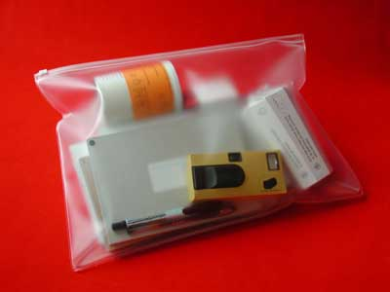
cultural probes
direct observation
sometimes hard
in the home
psychiatric patients, …
probe packs
items to prompt responses
e.g. glass to listen at wall, camera, postcard
given to people to open in their own environment they record what is meaningful to them
used to …
inform interviews, prompt ideas, enculture designers

Slide 19
scenarios
stories for design
use and reuse

Slide 20
scenarios
stories for design
communicate with others
validate other models
understand dynamics
linearity
time is linear - our lives are linear
but don’t show alternatives

Slide 21
scenarios …
what will users want to do?
step-by-step walkthrough
what can they see (sketches, screen shots)
what do they do (keyboard, mouse etc.)
what are they thinking?
use and reuse throughout design

Slide 22
scenario – movie player
Brian would like to see the new film “Moments of Significance” and wants to invite Alison, but he knows she doesn’t like “arty” films. He decides to take a look at it to see if she would like it and so connects to one of the movie sharing networks. He uses his work machine as it has a higher bandwidth connection, but feels a bit guilty. He knows he will be getting an illegal copy of the film, but decides it is OK as he is intending to go to the cinema to watch it. After it downloads to his machine he takes out his new personal movie player. He presses the ‘menu’ button and on the small LCD screen he scrolls using the arrow keys to ‘bluetooth connect’ and presses the select button. On his computer the movie download program now has an icon showing that it has recognised a compatible device and he drags the icon of the film over the icon for the player. On the player the LCD screen says “downloading now”, a percent done indicator and small whirling icon. … … …

Slide 23
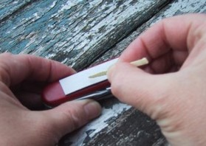
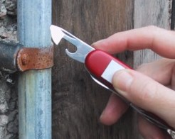
also play act …
mock up device
pretend you are doing it
internet-connected swiss army knife …
but where is that thumb?
use toothpick as stylus

Slide 24
… explore the depths
explore interaction
what happens when
explore cognition
what are the users thinking
explore architecture
what is happening inside

Slide 25
use scenarios to ..
communicate with others
designers, clients, users
validate other models
‘play’ it against other models
express dynamics
screenshots – appearance
scenario – behaviour

Slide 26
linearity
Scenarios – one linear path through system
Pros:
life and time are linear
easy to understand (stories and narrative are natural)
concrete (errors less likely)
Cons:
no choice, no branches, no special conditions
miss the unintended
So:
use several scenarios
use several methods

Slide 28
navigation design
the systems
info and help
management
messages
start
add user
remove user
local structure – single screen
global structure – whole site
main
screen
remove
user
confirm
add user

Slide 29
levels
widget choice
menus, buttons etc.
screen design
application navigation design
environment
other apps, O/S

Slide 30
the web …
widget choice
screen design
navigation design
environment
elements and tags
<a href=“...”>
page design
site structure
the web, browser, external links

Slide 31
physical devices
widget choice
screen design
navigation design
environment
controls
buttons, knobs, dials
physical layout
modes of device
the real world

Slide 32
think about structure
within a screen
later ...
local
looking from this screen out
global
structure of site, movement between screens
wider still
relationship with other applications

Slide 33
local
from one screen looking out

Slide 34
goal seeking
goal
start

Slide 35
goal seeking
goal
start
progress with local knowledge only ...

Slide 36
goal seeking
goal
start
… but can get to the goal

Slide 37
goal seeking
goal
start
… try to avoid these bits!

Slide 38
four golden rules
knowing where you are
knowing what you can do
knowing where you are going
or what will happen
knowing where you’ve been
or what you’ve done

Slide 39
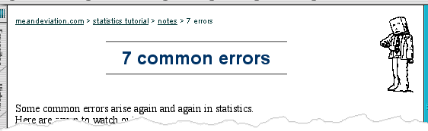
where you are – breadcrumbs
shows path through web site hierarchy
top level category
sub-category
web site
this page
live links
to higher
levels

Slide 40
beware the big button trap
things
other things
more things
the thing from
outer space
where do they go?
lots of room for extra text!

Slide 41
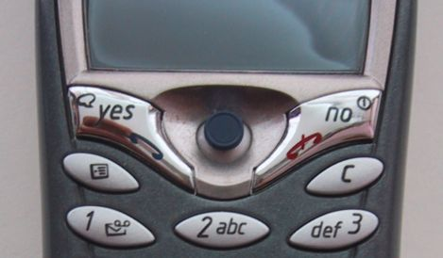
modes
lock to prevent accidental use …
remove lock - ‘c’ + ‘yes’ to confirm
frequent practiced action
if lock forgotten
in pocket ‘yes’ gets pressed
goes to phone book
in phone book … ‘c’ – delete entry ‘yes’ – confirm … oops !

Slide 42
global
between screens
within the application

Slide 43
hierarchical diagrams
the system
info and help
management
messages
add user
remove user

Slide 44
hierarchical diagrams ctd.
parts of application
screens or groups of screens
typically functional separation
the systems
info and help
management
messages
add user
remove user

Slide 45
navigating hierarchies
deep is difficult!
misuse of Miller’s 7 ± 2
short term memory, not menu size
optimal?
many items on each screen
but structured within screen
see /e3/online/menu-breadth/

Slide 46
think about dialogue
what does it mean in UI design?
Minister: do you name take this woman …
Man: I do
Minister: do you name take this man …
Woman: I do
Minister: I now pronounce you man and wife

Slide 47
think about dialogue
what does it mean in UI design?
marriage service
general flow, generic – blanks for names
pattern of interaction between people
computer dialogue
pattern of interaction between users and system
but details differ each time
Minister: do you name take this woman …

Slide 48
network diagrams
main
screen
remove
user
confirm
add user
show different paths through system

Slide 49
network diagrams ctd.
what leads to what
what happens when
including branches
more task oriented then hierarchy
main
screen
remove
user
confirm
add user

Slide 50
wider still
between applications
and beyond ...

Slide 51
wider still …
style issues:
platform standards, consistency
functional issues
cut and paste
navigation issues
embedded applications
links to other apps … the web

Slide 53
screen design and layout
✓
Dix , Alan
Finlay, Janet
Abowd, Gregory
Beale, Russell
basic principles
grouping, structure, order
alignment
use of white space
ABCDEFGHIJKLM
NOPQRSTUVWXYZ

Slide 54
basic principles
ask
what is the user doing?
think
what information, comparisons, order
design
form follows function

Slide 55
available tools
grouping of items
order of items
decoration - fonts, boxes etc.
alignment of items
white space between items

Slide 56
grouping and structure
logically together ⇒ physically together
Billing details:
Name
Address: …
Credit card no
Delivery details:
Name
Address: …
Delivery time
Order details:
item quantity cost/item cost
size 10 screws (boxes) 7 3.71 25.97
…… … … …

Slide 57
order of groups and items
think! - what is natural order
should match screen order!
use boxes, space etc.
set up tabbing right!
instructions
beware the cake recipie syndrome! … mix milk and flour, add the fruit after beating them

Slide 58
decoration
use boxes to group logical items
use fonts for emphasis, headings
but not too many!!
ABCDEFGHIJKLM
NOPQRSTUVWXYZ

Slide 59
alignment - text
you read from left to right (English and European)
⇒ align left hand side
boring but
readable!
Willy Wonka and the Chocolate Factory
Winston Churchill - A Biography
Wizard of Oz
Xena - Warrior Princess
Willy Wonka and the Chocolate Factory
Winston Churchill - A Biography
Wizard of Oz
Xena - Warrior Princess
fine for special effects but hard to scan

Slide 60
alignment - names
Usually scanning for surnames ⇒ make it easy!
✗
✓
Alan Dix
Janet Finlay
Gregory Abowd
Russell Beale
Dix , Alan
Finlay, Janet
Abowd, Gregory
Beale, Russell
✓
Alan Dix
Janet Finlay
Gregory Abowd
Russell Beale

Slide 61

alignment - numbers
think purpose!
which is biggest?
532.56 179.3 256.317 15 73.948 1035 3.142 497.6256

Slide 62
alignment - numbers
visually:
long number = big number
align decimal points
or right align integers
627.865 1.005763 382.583 2502.56 432.935 2.0175 652.87 56.34

Slide 63
multiple columns
scanning across gaps hard: (often hard to avoid with large data base fields)
sherbert 75 toffee 120 chocolate 35 fruit gums 27 coconut dreams 85

Slide 64
multiple columns - 2
use leaders
sherbert 75 toffee 120 chocolate 35 fruit gums 27 coconut dreams 85

Slide 65
multiple columns - 3
or greying (vertical too)
sherbert 75 toffee 120 chocolate 35 fruit gums 27 coconut dreams 85

Slide 66
multiple columns - 4
or even (with care!) ‘bad’ alignment
sherbert 75 toffee 120 chocolate 35 fruit gums 27 coconut dreams 85

Slide 67
white space - the counter
WHAT YOU SEE

Slide 68
white space - the counter
WHAT YOU SEE
THE GAPS BETWEEN

Slide 69
space to separate

Slide 70
space to structure

Slide 71
space to highlight

Slide 72
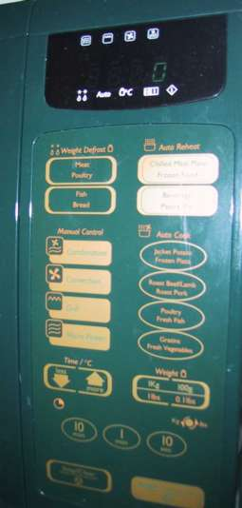
physical controls
grouping of items
defrost settings
type of food
time to cook
defrost settings
type of food
time to cook

Slide 73
physical controls
grouping of items
order of items
type of heating
temperature
time to cook
start
1) type of heating
1
2) temperature
3) time to cook
2
4) start
3
4

Slide 74
physical controls
grouping of items
order of items
decoration
different colours for different functions
lines around related buttons
different colours for different functions
lines around related buttons (temp up/down)

Slide 75
physical controls
grouping of items
order of items
decoration
alignment
centered text in buttons ? easy to scan ?
centred text in buttons
? easy to scan ?

Slide 76
physical controls
grouping of items
order of items
decoration
alignment
white space
gaps to aid grouping
gaps to aid grouping

Slide 78
user action and control
entering information
knowing what to do
affordances

Slide 79
entering information
Name:
Alan Dix
Address:
Lancaster
forms, dialogue boxes
presentation + data input
similar layout issues
alignment - N.B. different label lengths
logical layout
use task analysis (ch15)
groupings
natural order for entering information
top-bottom, left-right (depending on culture)
set tab order for keyboard entry
✓
Name:
Alan Dix
Address:
Lancaster
?
Name:
Alan Dix
Address:
Lancaster
N.B. see extra slides for widget choice

Slide 80
knowing what to do
what is active what is passive
where do you click
where do you type
consistent style helps
e.g. web underlined links
labels and icons
standards for common actions
language – bold = current state or action

Slide 81
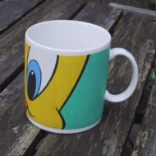
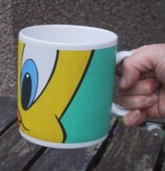
affordances
mug handle
psychological term
for physical objects
shape and size suggest actions
pick up, twist, throw
also cultural – buttons ‘afford’ pushing
for screen objects
button–like object ‘affords’ mouse click
physical-like objects suggest use
culture of computer use
icons ‘afford’ clicking
or even double clicking … not like real buttons!
‘affords’ grasping

Slide 82
appropriate appearance
presenting information
aesthetics and utility
colour and 3D
localisation & internationalisation

Slide 83
presenting information
purpose matters
sort order (which column, numeric alphabetic)
text vs. diagram
scatter graph vs. histogram
use paper presentation principles!
but add interactivity
softens design choices
e.g. re-ordering columns
‘dancing histograms’ (chap 21)
name
name
size
size
size
chap1
chap10
chap11
chap12
chap13
chap14
…
chap10
chap5
chap1
chap14
chap20
chap8
…
17
12
51
262
83
22
…
12
16
17
22
27
32
…

Slide 84

aesthetics and utility
aesthetically pleasing designs
increase user satisfaction and improve productivity
beauty and utility may conflict
mixed up visual styles ⇒ easy to distinguish
clean design – little differentiation ⇒ confusing
backgrounds behind text … good to look at, but hard to read
but can work together
e.g. the design of the counter
in consumer products – key differentiator (e.g. iMac)

Slide 85
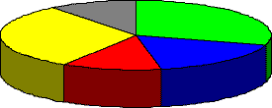
colour and 3D
both often used very badly!
colour
older monitors limited palette
colour over used because ‘it is there’
beware colour blind!
use sparingly to reinforce other information
3D effects
good for physical information and some graphs
but if over used … e.g. text in perspective!! 3D pie charts

Slide 86
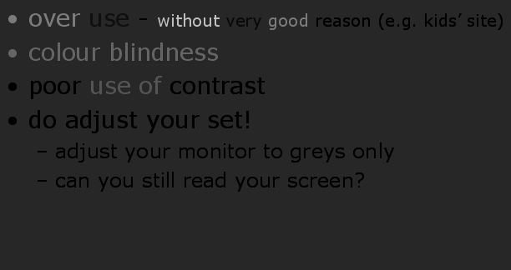
bad use of colour
over use - without very good reason (e.g. kids’ site)
colour blindness
poor use of contrast
do adjust your set!
adjust your monitor to greys only
can you still read your screen?

Slide 87
across countries and cultures
localisation & internationalisation
changing interfaces for particular cultures/languages
globalisation
try to choose symbols etc. that work everywhere
simply change language?
use ‘resource’ database instead of literal text … but changes sizes, left-right order etc.
deeper issues
cultural assumptions and values
meanings of symbols
e.g tick and cross … +ve and -ve in some cultures … but … mean the same thing (mark this) in others
✓
✗

Slide 89
prototyping

Slide 90
iteration and prototyping
getting better …
… and starting well

Slide 91
prototyping
you never get it right first time
if at first you don’t succeed …
OK?
design
prototype
evaluate
done!
re-design

Slide 92
pitfalls of prototyping
moving little by little … but to where
Malverns or the Matterhorn?
1. need a good start point
2. need to understand what is wrong

